Slide 1






AWS
AWS Account
aws account creation/signup for free trier usage
Hosted By:
Harikrishna Cheruku
DevOps Consultant & Solution Architect

Slide 2

Online payment card(credit or debit)
AWS account
What you need to get started?
Computer with internet connection
A web browser
Linux - SSH Client
Windows - RDP Client
Harikrishna Cheruku

Slide 3
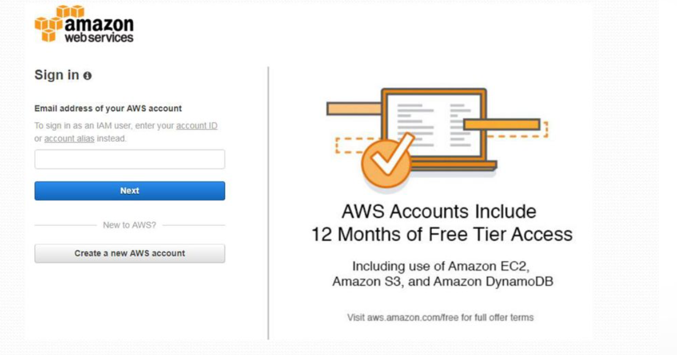
Online payment card(credit or debit)
Let’s Get Started
AWS account
Computer with internet connection
A web browser
Linux - SSH Client
Windows - RDP Client
Harikrishna Cheruku

Slide 4
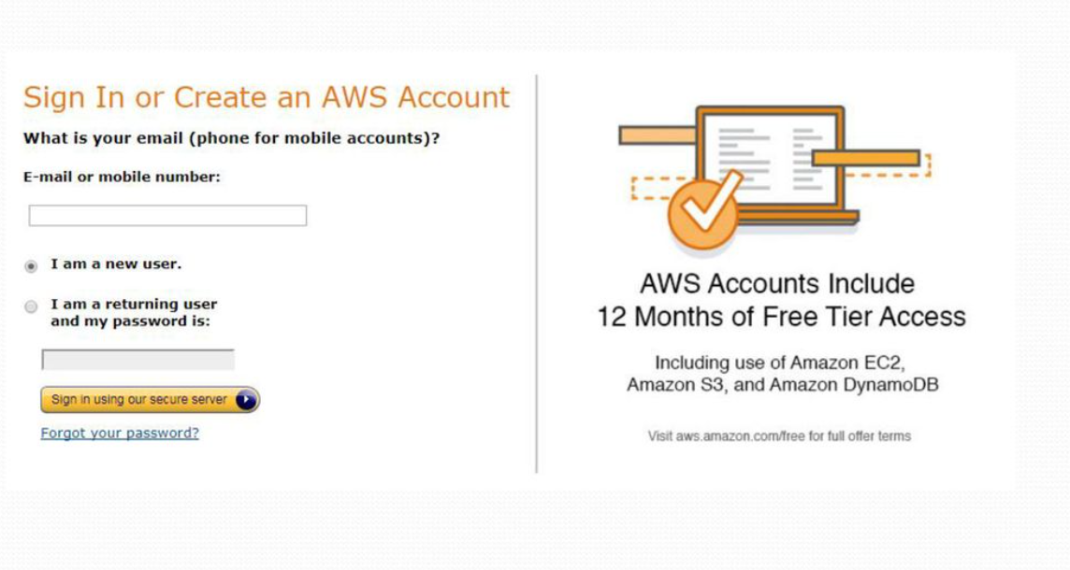
Online payment card(credit or debit)
Let’s Get Started
AWS account
Computer with internet connection
A web browser
Linux - SSH Client
Windows - RDP Client
Harikrishna Cheruku

Slide 5
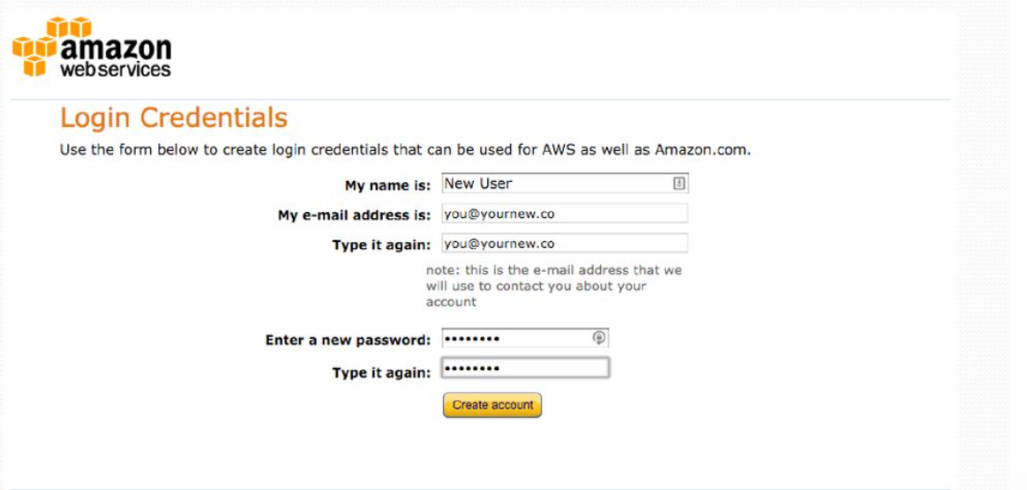
Online payment card(credit or debit)
Login Details
AWS account
Computer with internet connection
A web browser
Linux - SSH Client
Windows - RDP Client
Harikrishna Cheruku

Slide 6
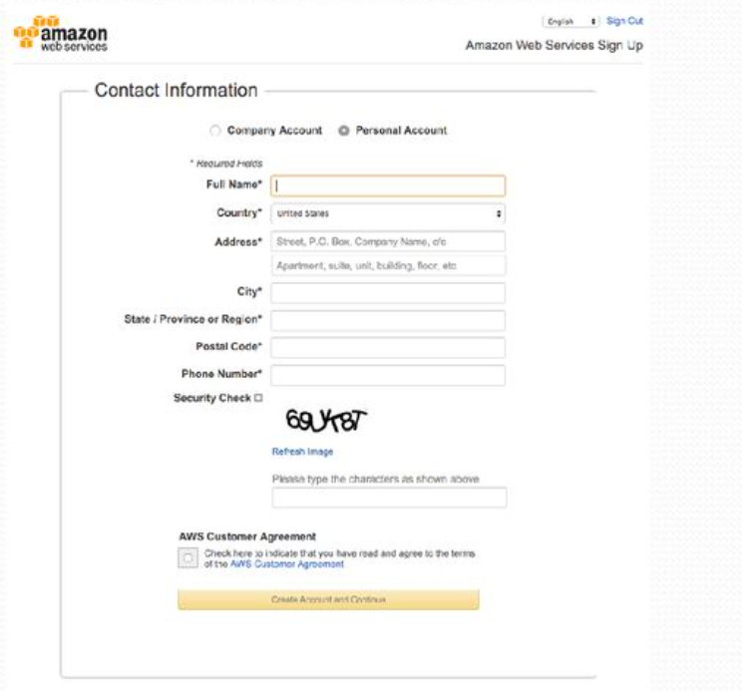
Contact Information
Harikrishna Cheruku

Slide 7
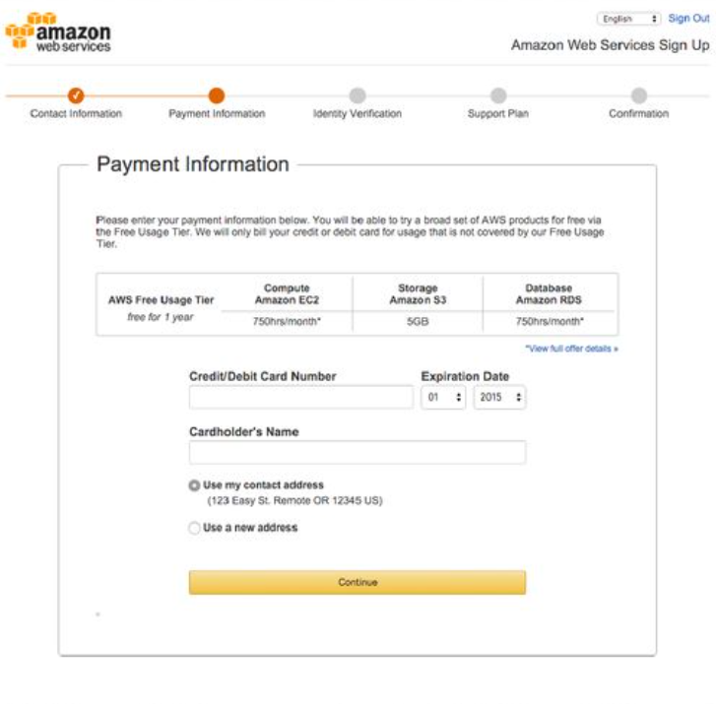
Credit or Debit Card
Harikrishna Cheruku

Slide 8
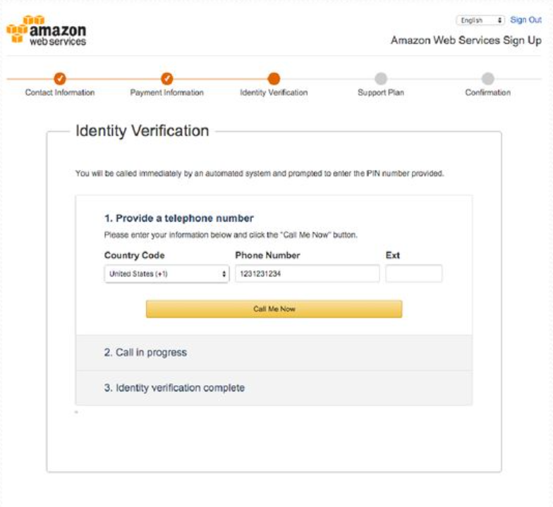
Phone Verification
Harikrishna Cheruku

Slide 9
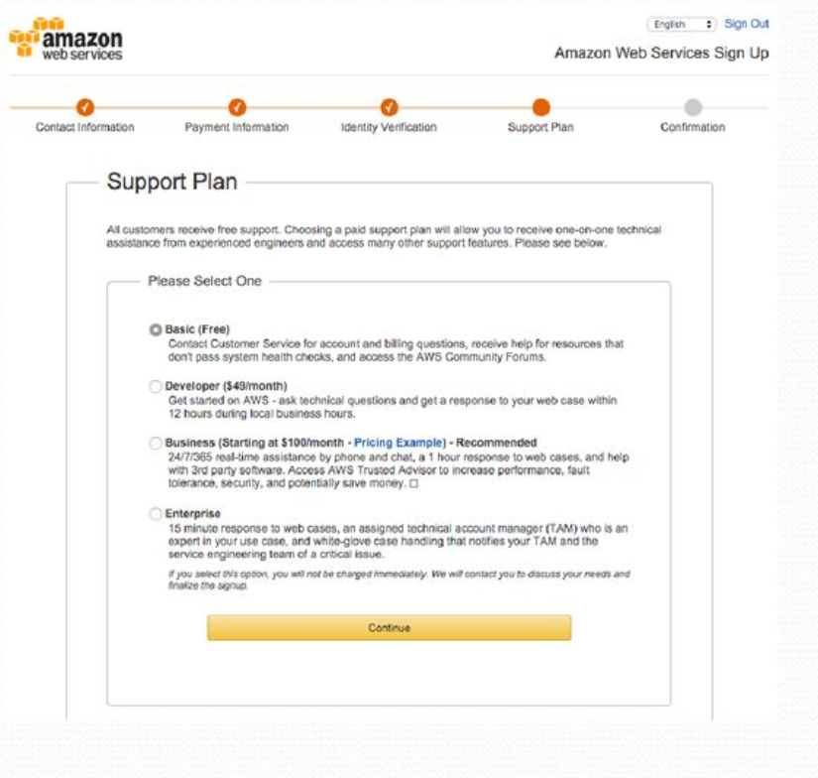
Basic Support Plan
Harikrishna Cheruku

Slide 10
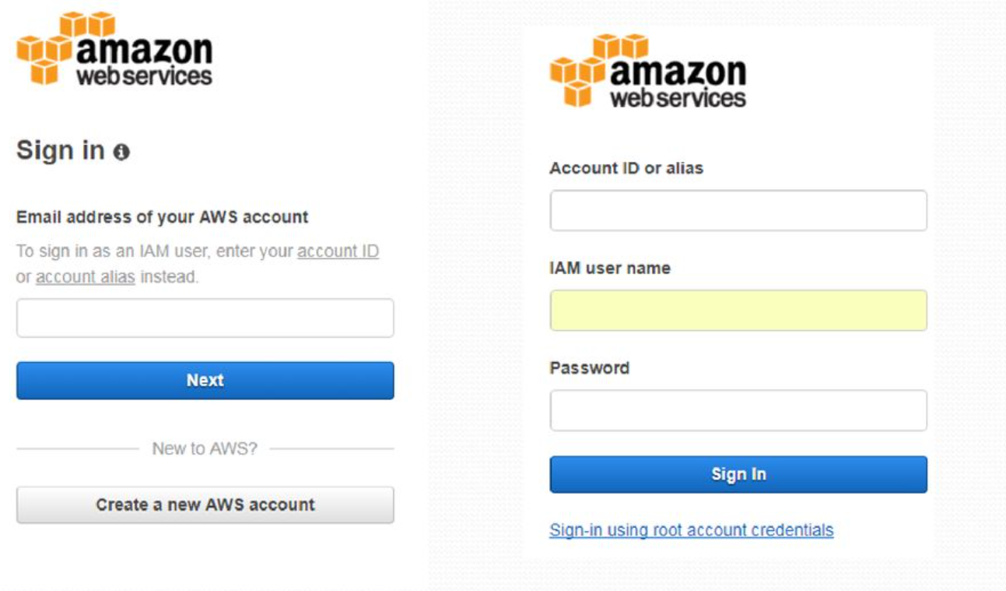
Basic Support Plan
Harikrishna Cheruku

Slide 11
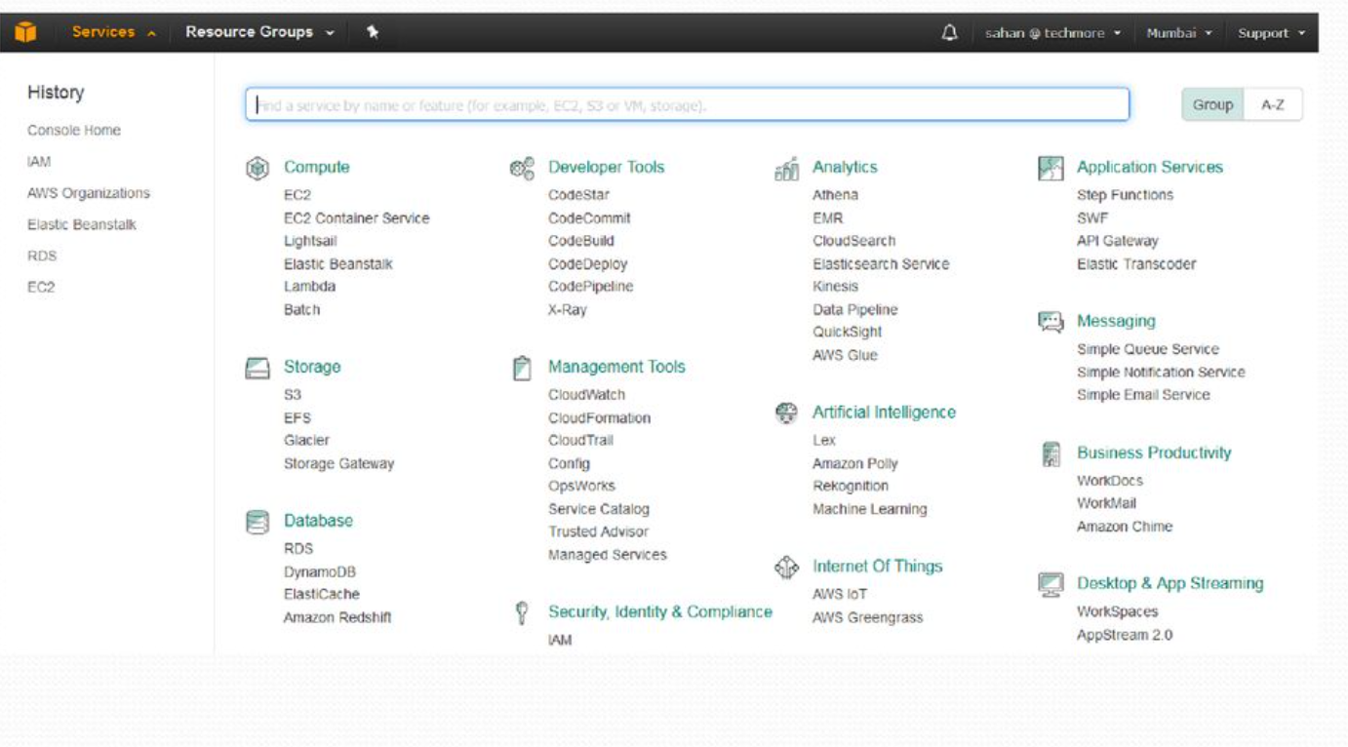
Explore the Console
Harikrishna Cheruku

